Slide 1
Chapter 20 Electrochemistry

Slide 2
1. Which substance is the oxidizing agent in the following reaction? __________.
Fe₂S₃ + 12HNO₃ → 2Fe(NO₃)₃ + 3S + 6NO₂ + 6H₂O
A) S
B) NO₂
C) Fe₂S₃
D) HNO₃
E) H₂O
D

Slide 3
2.What is the oxidation number of manganese in the MnO₄－ ion? __________.
A) +1
B) +2
C) +5
D) +4
E) +7
E

Slide 4
3. What is the coefficient of the dichromate ion when the following equation is balanced?
Fe²⁺ + Cr₂O₇²⁻ → Fe³⁺ + Cr³⁺ (acidic solution)
__________.
A) 1
B) 2
C) 3
D) 5
E) 6
A

Slide 5
4. The purpose of the salt bridge in an electrochemical cell is to ________.
A) provide a source of ions to react at the anode and cathode
B) Provide oxygen to facilitate oxidation at the anode
C) provide a means for electrons to travel from the anode to the cathode
D) provide a means for electrons to travel from the cathode to the anode
E) maintain electrical neutrality in the half-cells via migration of ions
E

Slide 6
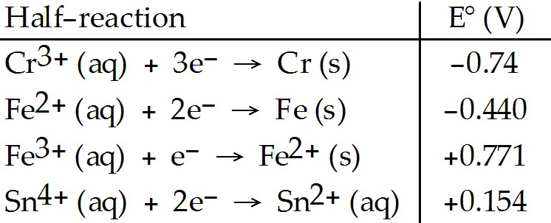
5. Which of the following reactions will occur spontaneously as written? ________.
A) Sn⁴⁺ (aq) + Fe³⁺ (aq) → Sn²⁺ (aq) + Fe²⁺ (aq)
B) 3Fe (s) + 2Cr³⁺ (aq) → 2Cr (s) + 3Fe²⁺ (aq)
C) Sn⁴⁺ (aq) + Fe²⁺ (aq) → Sn²⁺ (aq) + Fe (s)
D) 3Sn⁴⁺ (aq) + 2Cr (s) → 2Cr³⁺ (aq) + 3Sn²⁺ (aq)
E) 3Fe²⁺ (aq) → Fe (s) + 2Fe³⁺ (aq)
D

Slide 7
6. Consider an electrochemical cell based on the reaction:
2H⁺ (aq) + Sn (s) → Sn²⁺ (aq) + H₂ (g)
Which of the following actions would not change the measured cell potential? ________.
A) lowering the pH in the cathode compartment
B) addition of more tin metal to the anode compartment
C) increasing the tin (II) ion concentration in the anode
compartment
D) increasing the pressure of hydrogen gas in the cathode
compartment
E) Any of the above will change the measured cell
potential
B

Slide 8
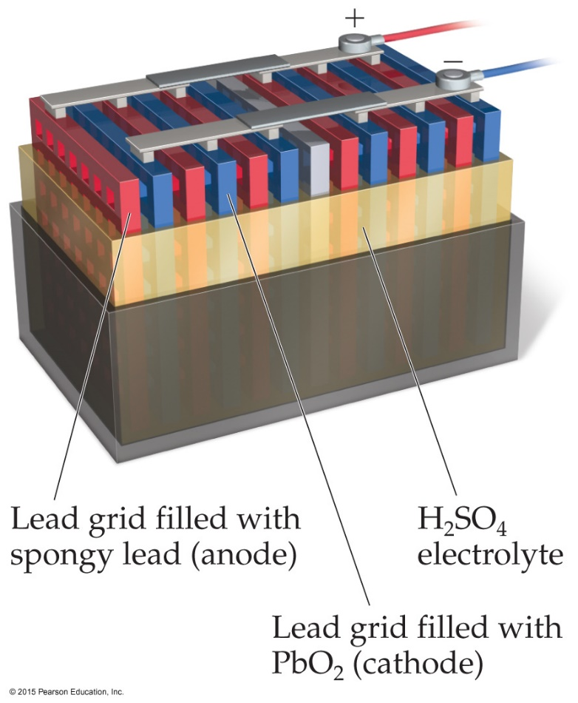
7. In a lead-acid battery, the electrodes are consumed. In this battery, ________.
A) the anode is Pb
B) the anode is PbSO4
C) the anode is PbO2
D) the cathode is PbSO4
E) the cathode is Pb
A

Slide 9
8. Cathodic protection of a metal pipe against corrosion usually entails ________.
attaching an active metal to make the pipe the anode in an electrochemical cell
B) coating the pipe with another metal whose standard
reduction potential is less negative than that of the pipe
C) attaching an active metal to make the pipe the cathode
in an electrochemical cell
D) attaching a dry cell to reduce any metal ions which
might be formed
E) coating the pipe with a fluoropolymer to act as a source
of fluoride ion (since the latter is so hard to oxidize)
C

Slide 10
9. One of the differences between a voltaic cell and an electrolytic cell is that in an electrolytic cell, ________.
A) an electric current is produced by a chemical reaction
B) electrons flow toward the anode
C) a nonspontaneous reaction is forced to occur
D) O₂ gas is produced at the cathode
E) oxidation occurs at the cathode
C

